Slide 1

JSON: JavaScript Object Notation
Sampath Jayarathna
Cal Poly Pomona

Slide 2
JSON as an XML Alternative
JSON = JavaScript Object Notation
It’s really language independent
most programming languages can easily read it and instantiate objects or some other data structure
JSON is a light-weight alternative to XML for data-interchange
Started gaining tracking ~2006 and now widely used
http://json.org/ has more information

Slide 3
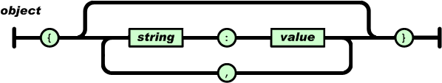
JSON Data – A name and a value
A name/value pair consists of a field name (in double quotes), followed by a colon, followed by a value
Unordered sets of name/value pairs
Begins with { (left brace)
Ends with } (right brace)
Each name is followed by : (colon)
Name/value pairs are separated by , (comma)
{
"employee_id": 1234567,
"name": "Jeff Fox",
"hire_date": "1/1/2013",
"location": "Norwalk, CT",
"consultant": false
}

Slide 4
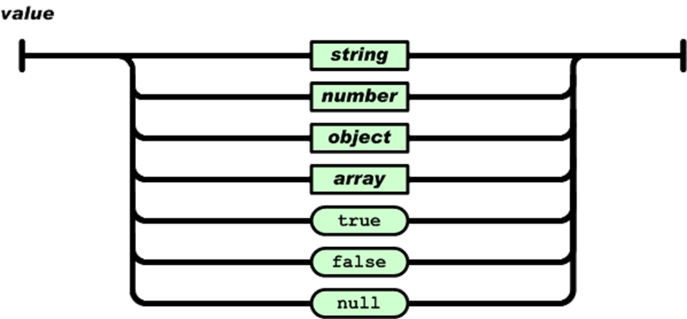
JSON Data – A name and a value
In JSON, values must be one of the following data types:
a string
a number
an object (JSON object)
an array
a boolean
null
{
"employee_id": 1234567,
"name": "Jeff Fox",
"hire_date": "1/1/2013",
"location": "Norwalk, CT",
"consultant": false
}

Slide 5
JSON Data – A name and a value
Strings in JSON must be written in double quotes.
{ "name":"John" }
Numbers in JSON must be an integer or a floating point.
{ "age":30 }
Values in JSON can be objects.
{ "employee":{ "name":"John", "age":30, "city":"New York" } }
Values in JSON can be arrays.
{ "employees":[ "John", "Anna", "Peter" ] }

Slide 6
Another example: XML vs JSON
<?xml version="1.0"?>
<employees> <employee> <firstName>John</firstName> <lastName>Doe</lastName> </employee> <employee> <firstName>Anna</firstName> <lastName>Smith</lastName> </employee> <employee> <firstName>Peter</firstName> <lastName>Jones</lastName> </employee> </employees>
{"employees":[ { "firstName":"John", "lastName":"Doe" }, { "firstName":"Anna", "lastName":"Smith" }, { "firstName":"Peter", "lastName":"Jones" } ]}

Slide 7
Class Activity 8
Convert the following bookstore.xml to bookstore.json
<?xml version="1.0"?>
<bookstore>
<book category="sci-fi">
<title lang="en"> 2001</title>
<author>Arthur C. Clarke</author>
<price>$30.0</price>
<year>1968</year>
</book>
<book>
<title lang="rs">Story about a True Man</title>
<author>Boris Polevoy</author>
<price>$20.00</price>
<year>1952</year>
</book>
</bookstore>

Slide 8
XML vs JSON
JSON is Like XML Because
Both JSON and XML are "self describing" (human readable)
Both JSON and XML are hierarchical (values within values)
Both JSON and XML can be parsed and used by lots of programming languages
JSON is Unlike XML Because
JSON doesn't use end tag
JSON is shorter
JSON is quicker to read and write
JSON can use arrays
JSON has a better fit for OO systems than XML
The biggest difference is:
XML has to be parsed with an XML parser. JSON can be parsed by a standard JavaScript function.

Slide 9
Why JSON?
Steps involved in exchanging data from web server to browser involves:
Using XML
Fetch an XML document from web server.
Use the XML DOM to loop through the document.
Extract values and store in variables.
It also involves type conversions.
Using JSON
Fetch a JSON string.
Parse the JSON using JavaScript functions.

